Slide 1
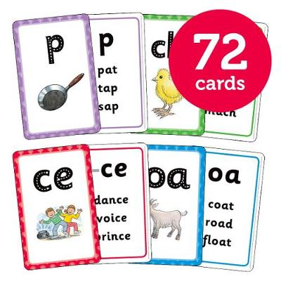
Workshop
Come along to our Floppy’s Phonics workshop on Wednesday 22nd February at 3.45pm – 4.20pm.
We will show you how we teach Floppy’s Phonics in school and share resources you can use to support your children at home.
We will have members of staff available to care for your St. Chad’s children while you attend the workshop.
Please text the school on 07786201169 if you would like to come along, letting us know how many adults will be attending and which St. Chad’s children will need taking care of at this time.
Thank you and we look forward to seeing you there!

Slide 2
Aims for the session:
To share how we teach phonics in school
To support you in understanding how phonics works and why we use it to support early reading
To share the resources available for you the support phonics at home
To explain how to use these resources to best help your child
To answer any questions you might have about phonics

Slide 4
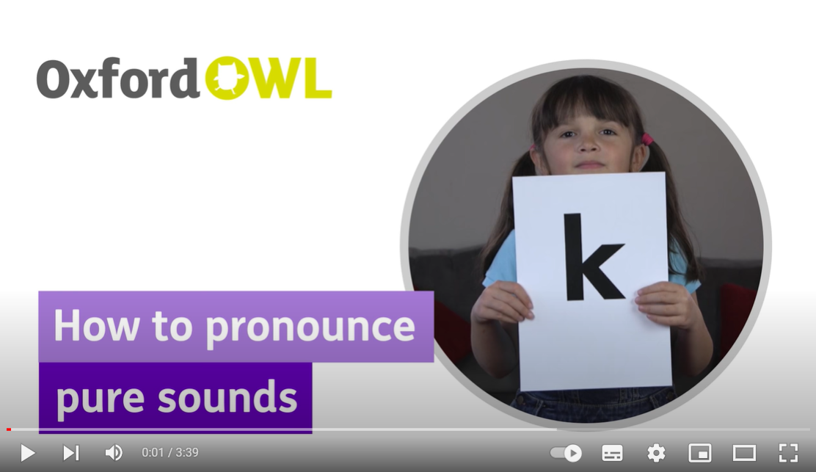
Using only the pure sounds

Slide 6
Floppy’s Phonics Online
In session one we:
Revise and revisit previously learnt sounds
Teach a new sound using Floppy’s Phonics online
Practise using and identifying that sound in speaking and listening activities

Slide 7
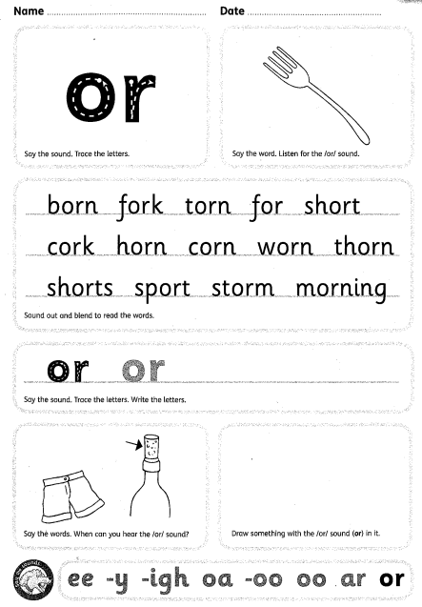
Floppy’s Phonics Activity Sheets
In session two we:
Practise our new and revised sounds on the activity sheets
Apply our new learning through reading and spelling activities

Slide 8
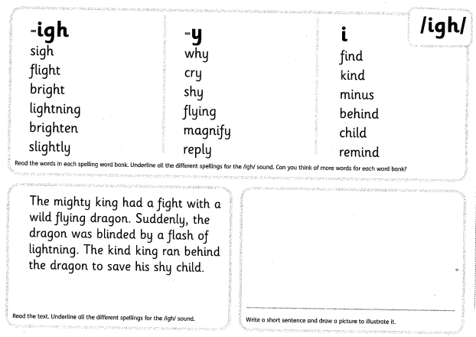

Slide 9
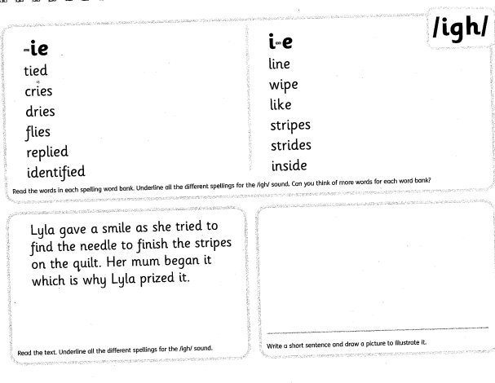

Slide 10
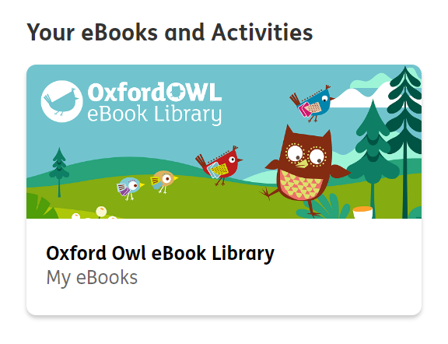
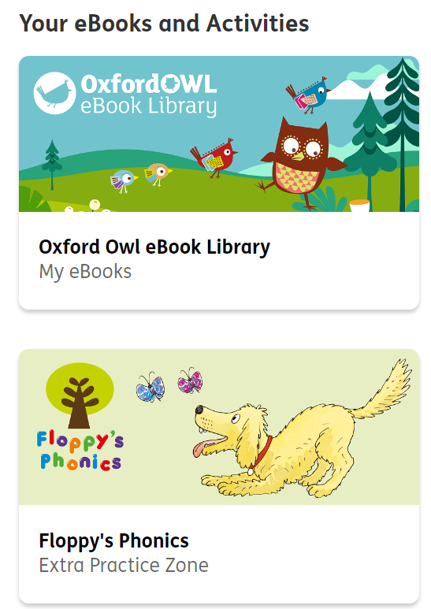
Floppy’s Phonics at home
Activity sheet homework
Floppy’s Phonics online
Class log in
Username: St Chad’s Year One
Password: blueberries
Username: St Chad’s Reception
Password: penguins
Books online / from school

Slide 11
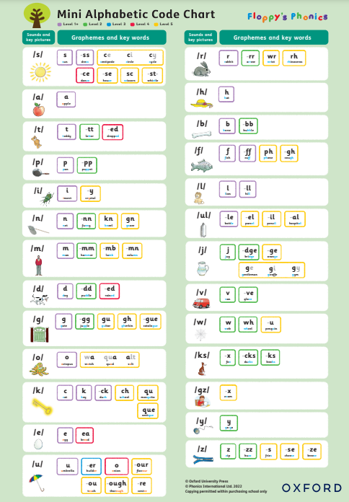
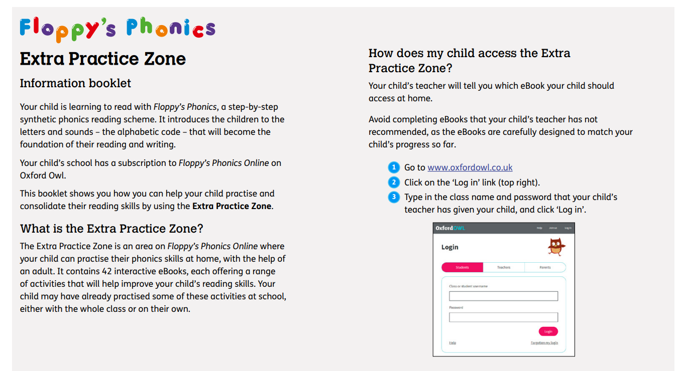
Extra Resources
Parent support booklet
Not currently supported for use on iPad and iPad mini running iOS 13 or above.
Mini alphabetic code chart
How to videos

Slide 12
Any questions?

